Slide 1
Automate Azure infrastructure
Like a boss!
Kamil Mrzygłód, Cloudyna 2019

Slide 2

Architecture vs Infrastructure

Slide 3
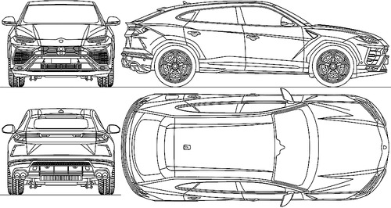

Slide 4


Slide 5
Comparison

Slide 6
Azure Resource Manager
Our architecture

Slide 7
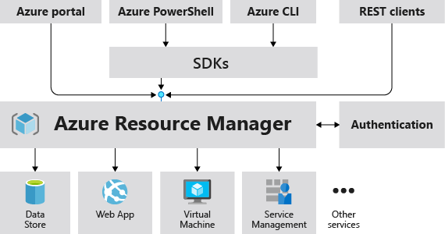

Slide 8
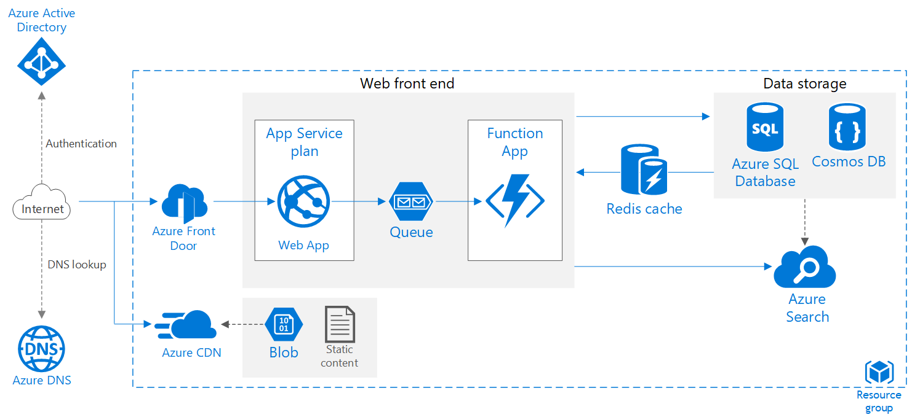

Slide 9
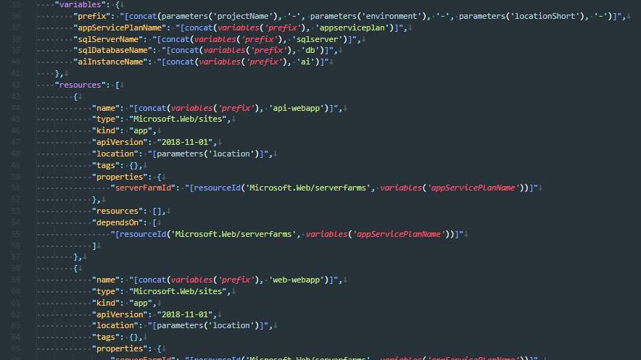

Slide 10
What’s next?

Slide 11
Automate & Deploy

Slide 12
ARM Template
Bare metal infrastructure deployment

Slide 13
Demo 1
ARM Template + Azure CLI

Slide 14
Conclusions
Declarative approach
Azure CLI as a runner
Requires upfront creation of a resource group
Easy way to provide parameters via parameters files
Saved as deployment in Azure

Slide 15
Azure CLI
Cross-platform, IT Pro friendly way ;)

Slide 16
Demo 2
Azure CLI

Slide 17
Conclusions
Imperative approach
Requires proper API implemented in Azure CLI
Easier way to introduce logic
Simpler, cleaner, more robust way of defining infrastructure

Slide 18
Fluent API
You see me rollin’, they hatin’…

Slide 19
Demo 3
Fluent API(aka Management SDK)

Slide 20
Conclusions
Imperative approach
Requires proper API implemented in the SDK
Requires particular language support
May not work on all platforms
Easy to incorporate into test suites

Slide 21
Terraform
You see me rollin’, they hatin’…

Slide 22
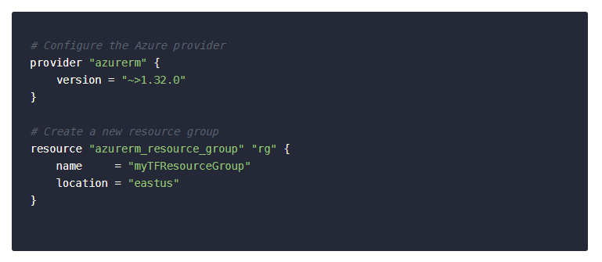

Slide 23

Demo 4
Terraform

Slide 24
Conclusions
Declarative approach
Levarages HQL
Third-party
Requires special runner
Helps in understanding the impact of of the changes
In many ways similar to ARM templates(parameters, functions)

Slide 25
What do we have?
Declarative
Imperative
ARM Template
Terraform
Azure CLI
Fluent SDK
Pulumi

Slide 26
Enhance your deployments
Tags, locks, principals, roles…

Slide 27
Tag everything, everywhere…

Slide 28
Demo 6
Quering resources by tags

